Slide 1
Object Oriented Programming
Abstracts and interfaces

Slide 2
SOLID principals
Single responsibility – encapsulation
Open for extension, closed for modification – inheritance
Liskov substitution – polimorphism is tool of specialization
Interface segregation – functional encapsulation
Dependency inversion – Depend on absztraction, not implementation

Slide 3
Liskov substitution principal
Let q(x) be a property provable about objects of x of type T. Then q(y) should be provable for objects y of type S where S is a subtype of T.
objects in a program should be replaceable with instances of their descendant classes without altering the correctness of that program

Slide 4
Methods - review
Collection of logically related instructions
Methods are used to perform certain actions
Methods are referenced by name – message identifier
Not independent components, parts of objects

Slide 5
Formal method declaration
<visibility>
[type parameter]
<return type>
<method name>([formal parameters])
{
<method body>
}

Slide 6
Class hierarchy – behavior abstraction
cat.say() => ”Meow”
dog.say() => ”Bark”
Abstraction
With generalization, Mammal would be the parent class
containing generic behavior say
but what does this Mammal.say do?
On abstraction level of Mammal, existence of say method is required, but operation is not interpretable

Slide 7
Abstract behavior
When a behavior
is expected from a point of a branch of the class hierarchy – generic level
is introduced on a certain level of abstraction – parent
is not interpretable until a certain point of the abstraction hierarchy – abstract
the behavior is said to be abstract between point of introduction and interpretation

Slide 8
Abstract method
By declaration, its existence is expected, but the implementation is not known.
The method has no exact implementation → has no method body
Has to be marked by abstract modifier

Slide 9
Formal declaration of abstract method
abstract
<visiblity>
[type parameter]
<return type>
<method name>([formal parameters]); // No method body

Slide 10
Abstract class
A class which contains abstract methods, its full implementation is not known.
Abstract class
Can not be instantiated – the implementation of a class is not defined
To make such a class work, abstract behaviors have to be specified – override
To give space to polymorphism, abstract class has to be inherited
Has to be marked with abstract modifier

Slide 11
Abstract class properties
Marked with abstract modifier
Can not be instantiated
As a class, a part of the class hierarchy – inheritance
Can be target type of cast
Can contain abstract method – but not necessary
Can contain implemented (non-abstract) method – but not necessary

Slide 12
Class hierarchy – abstraction
abstract class Mammal {
abstract public String say();
}
class Cat extends Mammal {
public String say() { return ”Meow”; }
}
class Dog extends Mammal {
public String say() { return ”Bark”; }
}

Slide 13
Cast to abstract type
Cat cat = new Cat();
Dog dog = new Dog();
cat.say(); // => ”Meow”
dog.say(); // => ”Bark”
Mammal mammal = (Mammal)cat;
mammal.say(); // => ”Meow” using interface of Mammal class
mammal = (Mammal)dog;
mammal.say(); // => ”Bark” using interface of Mammal class

Slide 14
Class hierarchy – class sbstraction
In real life, instenace of vehicle does not exist (when examining cars and buses)
therefore Vehicle cannot be instantiated.
Object
Therefore:
Even if Vehicle has no abstract methos, still marked as
abstract class
Vehicle
Car
Bus

Slide 15
Class hierarchy – multiple inheritance
Elevator is not a Vehicle
Multiple inheritance is not supported in Java
Elevator should inherit PersonalTransport
Object
Vehicle
Elevator
behavior getNumberOfPersons is added to Vehicle
Elevator can also transport people, so behavior getNumberOfPersons is expected
Personal Transport
Truck
Car
Bus

Slide 16
Interface – review
Abstract, structural definition of a one direction connection surface.
Declares the usage modes of the program component – object .
A contract about expected behaviors of a class.
Caller Class
Class
Property A
Interface
Property 1
Property B
Property 2
Behaviour A
Behaviour 1
Behaviour B
Behaviour 2

Slide 17
Interface definition of a class
By class developer (designer)
Usage of class instances is specified
By setting visibility modifiers
According to abstract interface sub-principal, mainly methods are involved
Class interface contains all public components of the class (own and inherited)

Slide 18
Java interface
A collection of abstract method definitions
Can NOT be used to create objects – no instantiation
Can be defined separately
Not part of class hierarchy
Interface can be implemented by any classes – implements keyword
A class can implement more interfaces
Can be used as a type for cast

Slide 19
Class hierarchy – with interface
abstract getWeight is defined
Object
Cargo
Interface
Personal Transport
Interface
Vehicle
Elevator
abstract getNumberOfPersons is defined
Elevator can transport people and materials, so behavior getNumberOfPersons and getWeight is expected
Personal Transport
Truck
Car
Bus

Slide 20
Class hierarchy – with interface
abstract getWeight is defined
Object
Cargo
Interface
Personal Transport
Interface
Vehicle
Elevator
abstract getNumberOfPersons is defined
Elevator can transport people and materials, so behavior getNumberOfPersons and getWeight is expected
Truck
Car
Bus

Slide 21
Interface definition
interface PersonalTransport {
int getNumberOfPersons();
}
class Car extends Vehicle implements PersonalTransport {
private int numberOfPersons;
public int getNumberOfPersons() { return numberOfPersons; }
}

Slide 22
Abstract class vs Interface
Abstract class
Interface
Can contain abstract and non-abstract methods
Can be empty
Can contain any kind of variables
Can contain any kind of implementation
Can have components of any visibility
Contains only abstract methods
Can be empty
Can contain static and final variables
Can not contain implementation
Can have only public components

Slide 23
Abstract class vs Interface
Abstract class
Interface
Can have one ancestor: extends
Default ancestor: Object
Can prescribe behaviors – but hot have to
Can be target of type cast
Part of class hierarchy
Usage: To derive – extends
Can be used in single inheritance
Can have many ancestor : extends
Default ancestor: has no default
Can prescribe behaviors – but not have to
Can be target of type cast
Not part of class hierarchy
Usage: To implement – implements
Can be used in many implementations

Slide 24
Cast a reference – review
A reference of new type is created to the original object
Cast changes the type of reference, not the original object
Type of created reference specifies the access interface of the original object
Casting in class hierarchy tree
on the branch of object
from type of object
until the root (Object) and back

Slide 25
Cast a reference – interface
Because
Type of new reference specifies the access interface of the original object
Thus
When an object or its ancestor implements an interface, then the reference of the object can (implicitly) be casted to that interface,
independently from position in class hierarchy

Slide 26
Cast reference
Car car = new Car();
Bus bus = new Bus();
PersonalTransport transporter;
transporter = (PersonalTransport)car;
transporter.getNumberOfPersons();
transporter = (PersonalTransport)bus;
transporter.getNumberOfPersons();
Both Car and Bus implement PersonalTransport interface

Slide 27
Sort Integer list
ArrayList<Integer> numbers = new ArrayList<>();
for(int i=0;i<100;i++) {numbers.add(rnd.nextInt(100)); }
Collections.sort(numbers);

Slide 28
Sort String list
ArrayList<String> strings = new ArrayList<>();
for(int i=0;i<100;i++) { Strings.add(getRandomString()); }
Collections.sort(strings);

Slide 29
Sort list of custom objects
ArrayList<MyClass> items = new ArrayList<>();
for(int i=0;i<100;i++) { items.add(new MyClass()); }
Collections.sort(items);

Slide 30
Default sort of lists
Does work, because Integer can be sorted in increasing order of value by default?
Does work, because Strings can be sorted in alphabetical order by default?
Does not work, because no default sort criteria for MyClass?

Slide 31
Sort of list of custom objects
class MyClass implements Comaparable {
public int compareTo(Object o) { return 0; }
}
ArrayList<MyClass> items = new ArrayList<>();
for(int i=0;i<100;i++) { items.add(new MyClass()); }
Collections.sort(items);

Slide 32
Sort of list of custom objects type parameter
class MyClass implements Comaparable<MyClass> {
public int compareTo(MyClass other) { return 0; }
}
ArrayList<MyClass> items = new ArrayList<>();
for(int i=0;i<100;i++) { items.add(new MyClass()); }
Collections.sort(items);

Slide 33
Interface segregation
Clients should never be forced to implement an interface that it doesn’t use
And clients shouldn’t be forced to depend on methods they do not use

Slide 34
Class hierarchy design
Single Responsibility Principal
Members of a class are encapsulated by the responsibility zone.
Cohesion – atomicity
Methods of a class are stick together by common data and internal references.
Optimal Coupling – dependency of classes
Which part of the class hierarchy is affected by a change of a class

Slide 35
Cohesion and Coupling
Cohesion
A logical connection between data members and methods inside a class.
The base of encapsulation.
Coupling
Inter class dependency, how classes use resources of each other.
Client-server connections used for solving tasks are described, not ancient-descendant relation of the abstraction hierarchy.
When a class A uses resources of class B, then A depends on B.

Slide 36
Class dependencies
Site
ArrayList
Main
Vehicle
Car
Console
Bus

Slide 37
Cohesion
A class should have only one task or responsibility (depending on abstraction level).
Base of cohesion and inherence is the responsibility!
When designing encapsulation and class hierarchy, consider the responsibility zones.
Cohesion is not just between methods, data and internal references, but also can be a connection with other methods in the class.
On which functional change should the class also be changed?

Slide 38
Dependency – Coupling
Non-inherent, but cooperative classes are dependent and called coupled, when the type of server is known by the client.
The classes are independent, when the client knows only the interface required to complete a task (and that the server does implement is).

Slide 39
Cohesion and coupling
Cohesion
Coupling
Represents the degree to which a part of a code base forms a logically single, atomic unit.
Degree of atomicity.
represents the degree to which a single unit is dependent from others.
It is the number of connections between units.
The fewer the number, the lower the coupling.

Slide 40
Dependency inversion
Depend on abstraction, not implementation.
Entities must depend on abstractions, not on concretions. It states that the high-level module must not depend on the low-level module, but they should depend on abstractions.
This principle allows for decoupling.

Slide 41
Decoupling
Its aim is to decrease the effect of classes on the dependency structure (graph)
Tools
Use interface to describe connection – instead of class
Inversion of control
Dependency injection

Slide 42
Desctructive decoupling
public class Order {
private ArrayList<IOrderLine> _lines;
public Order(IOrderLineFactory factory,
IOrderPriceCalculator calculator) {
_factory = factory;
_calculator = calculator;
}
public double amount {
get { return _calculator.calculateAmount(_lines); }
}
public void addLine(IProduct product, double price) {
_lines.add(_factory.createOrderLine(product, price));
}
}

Slide 43
Destructive decoupling
IOrderLineFactory
OrderLineFactory
Order
IOrderPriceCalculator
OrderPriceCalculator
IProduct
Product
Decoupling breaks readability and sustainability

Slide 44
Ideal coupling - dependency
public class Order {
private ArrayList<OrderLine> _lines;
public double amount {
get { return _lines.sum(x -> x.Price); }
}
public void addLine(Product product, double amount) {
_lines.add(new OrderLine(product, amount));
}
}

Slide 45
Ideal coupling - dependency
OrderLine
Order
Product
Decoupling is unnecessary, if components will never (no chance at all) be used by their own (independently)

Slide 46
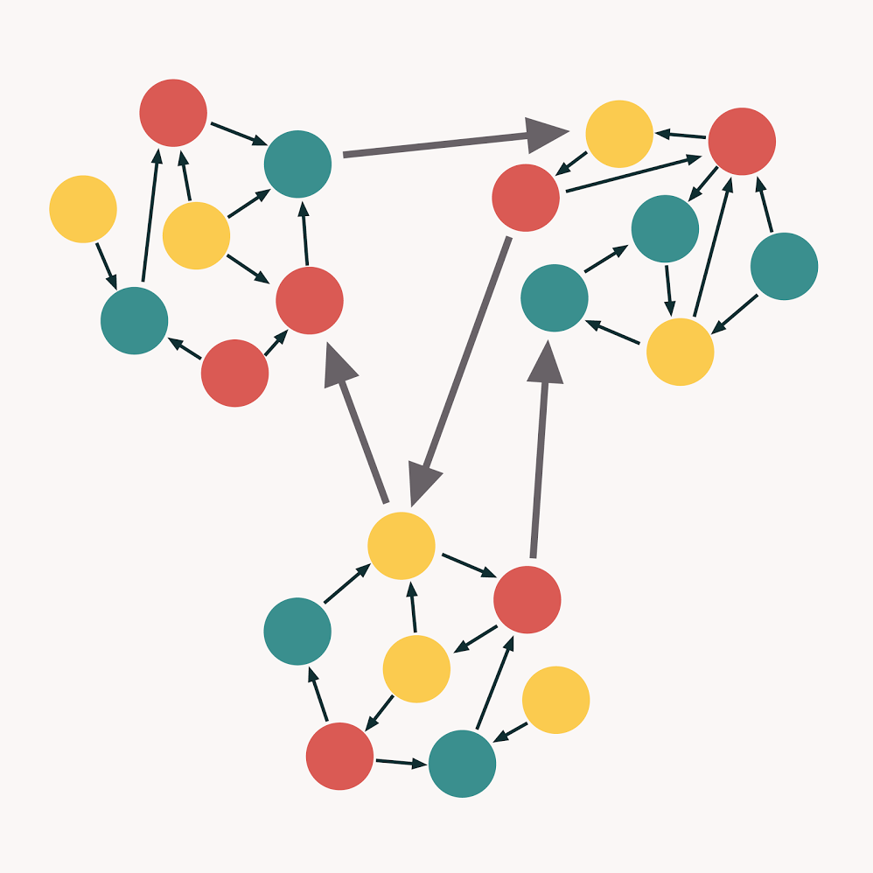

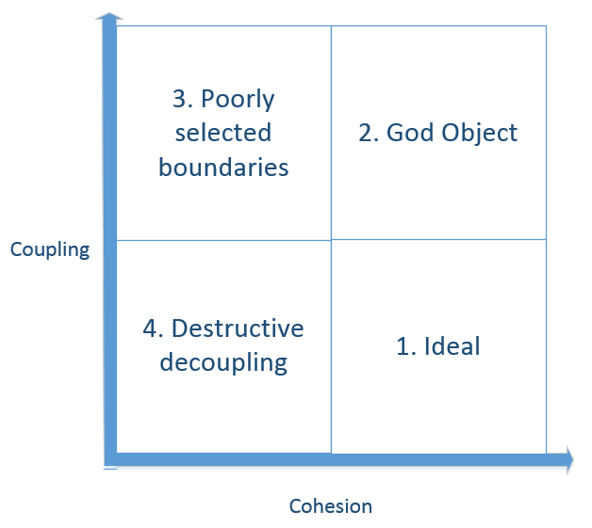
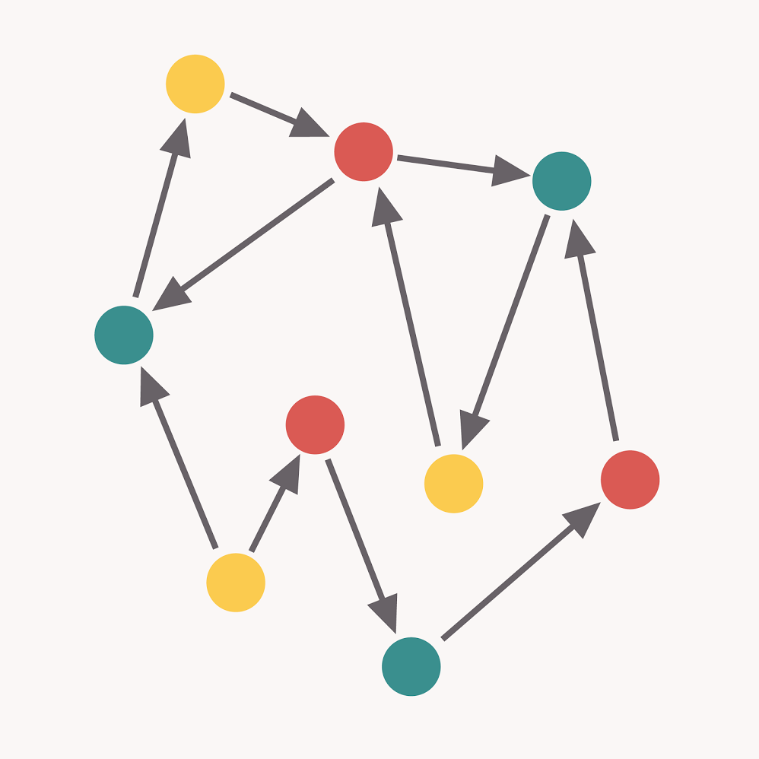
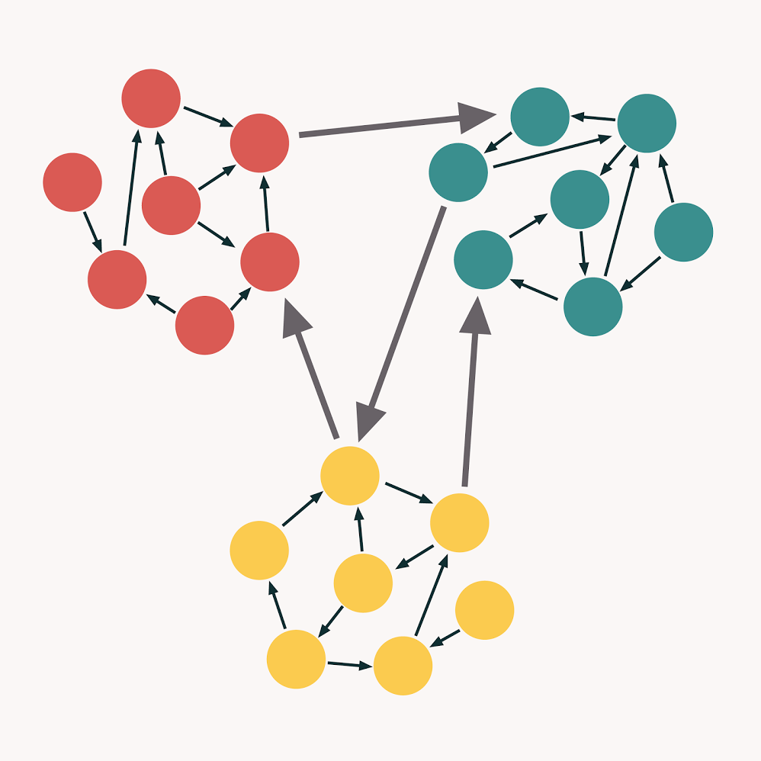
Cohesion and Coupling

Slide 47
Generic program flow
Specific execution
Custom operation A
General execution
Custom operation B
Custom operation C
Custom operation B
Custom operation D
Generic operation (B)

Slide 48
Inversion of control
Custom-written portions of a computer program receive the flow of control from a generic framework.
Generic framework
Genric code A
Custom code A
Execution
Genric code B
Custom code B

Slide 49
Dependency Injection
Generic framework uses generic interfaces
Custom code parts implement generic interfaces
Generic framework is executed
Custom written parts are injected on generic framework execution
Custom written code is executed by the framework via generic interfaces
Generic framework
Genric code A
Generic interface A
Custom code A
Execution
Genric code B
Generic interface B
Custom code B

Slide 50
Inversion of control – example
Generic comparator calls specific lambda to get values to compare.
ArrayList<Car> cars = new ArrayList<>();
cars.sort(
Comparator.comparing( c -> c1.getComfortLevel() )
);

